Slide 1
Tutorial #7 H8s/2377 Data Transfer
Dr. Sundaram Suresh Microprocessor Programming

Slide 2
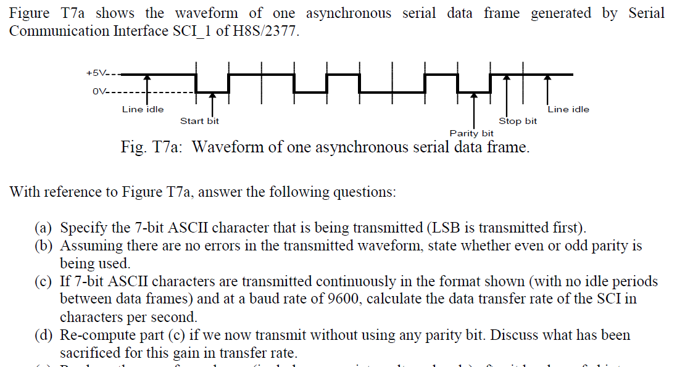
7.1 Serial Data Transfer

Slide 3
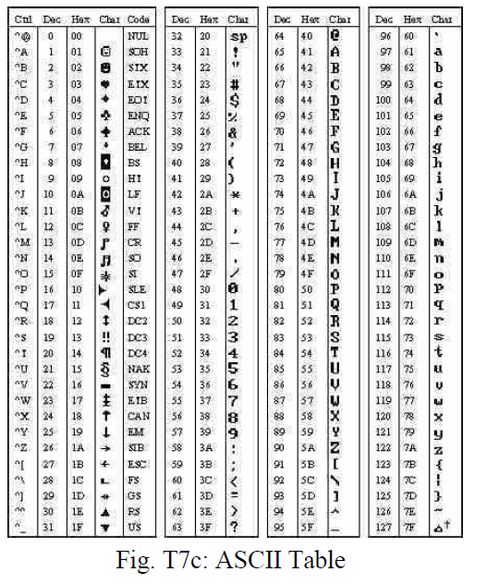
ASCII Table

Slide 4
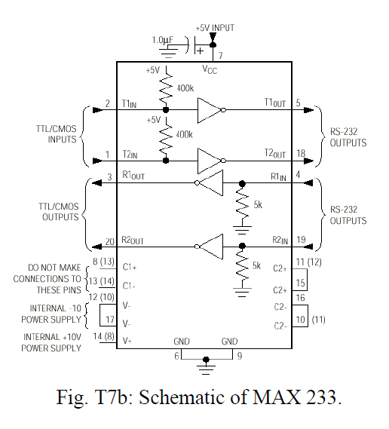
7.1 Serial Data Transfer
E) Re-draw the waveform shown (include appropriate voltage-levels) after it has been fed into a MAX233 line driver to produce a RS-232C compatible signal.
You may assume that voltage supply (Vcc) powering the MAX233 line driver chip is +5V.

Slide 5
RS-232
Logic ‘0’ – Doubles the input supply voltage +5V to +15V
Logic ‘1’ – Invert the voltage -5V to – 15V
See. Section 15 of Serial data communication
Read more about RS-232 in the website
http://www.maxim-ic.com/app-notes/index.mvp/id/83

Slide 6
Different register in serial communication
Serial Mode Register (SMR) H’FFFF80
SMR is used to set the SCI’s serial transfer format and select the on-chip baud rate generator clock source.
Bit Rate Register (BRR) H’FFFF81
BRR is an 8-bit register that adjusts the bit rate.
Serial Control Register (SCR) H’FFFF82
SCR performs enabling or disabling of SCI transfer operations and interrupt requests, and selection of the transfer/receive clock source.
Transmit Data Register (TDR) H’FFFF83
TDR is an 8-bit register that stores transmit data.
Serial Status Register (SSR) H’FFFF84
SSR is a register containing status flags of the SCI and multiprocessor bits for transfer.
Receive Data Register (RDR) H’FFFF85
RDR is an 8-bit register that stores receive data.

Slide 7
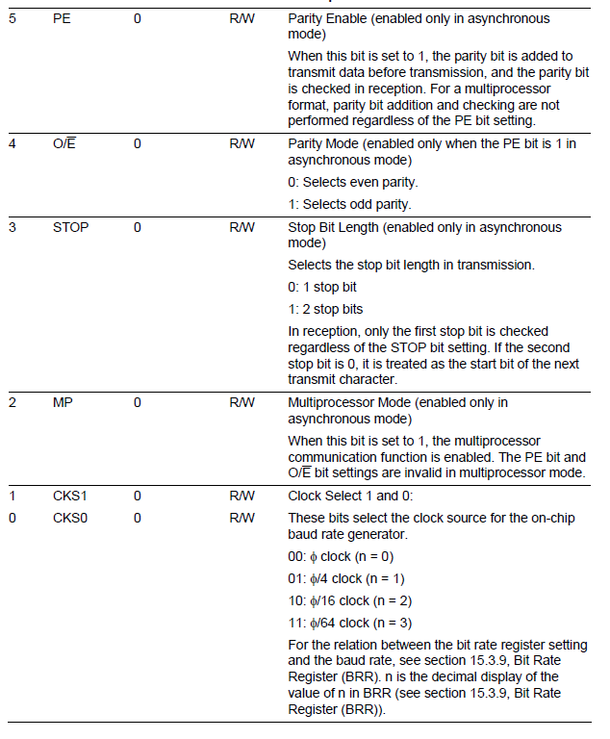
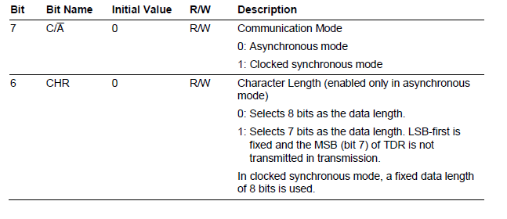
SMR

Slide 8
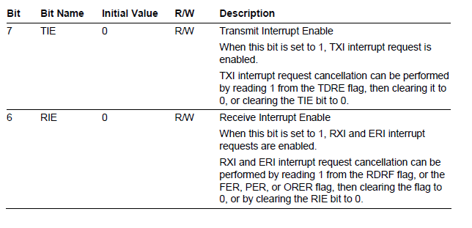
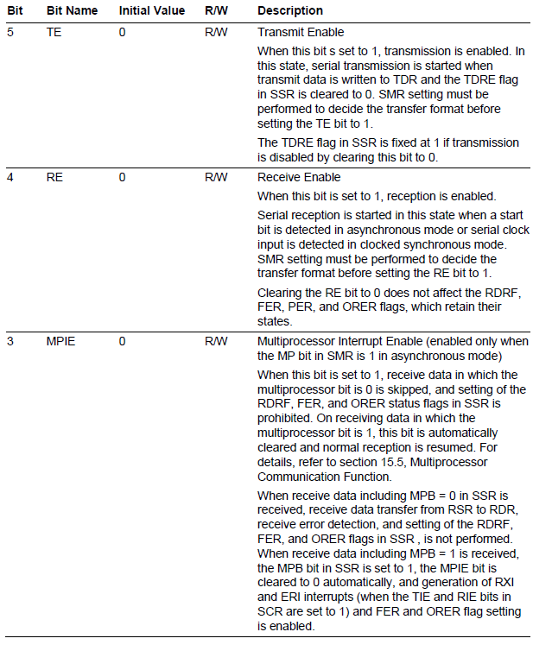
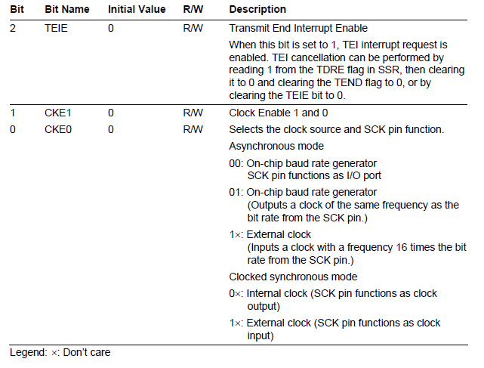
SCR

Slide 9
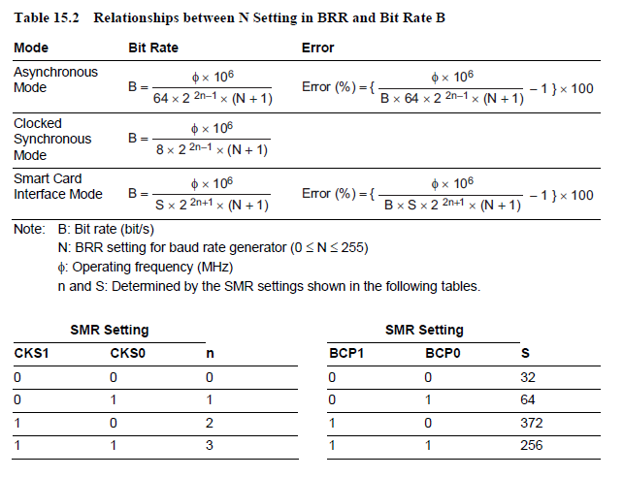
BRR

Slide 10
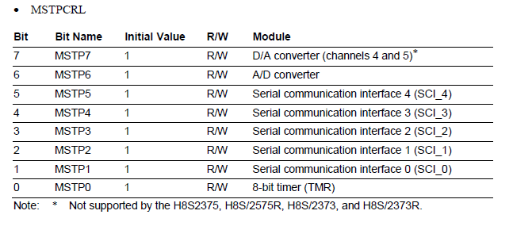
Module Stop Control Registers
MSTPCRL Address H’FFFF41

